Slide 1
SOEN 384
Management, Measurement and Quality Control http://users.encs.concordia.ca/~s384_2/
Lecture 21:
Agile Estimation and Planning(2):
Planning for value
Agile scheduling, tracking and communicating
Mike Cohn, “Agile estimating & planning”, Chapters 9, 11, 13, 14, 15, 16

Slide 2
Summary-level agenda
Review
Planning for value
Agile scheduling, tracking and communicating
SOEN384-L21:: Agile scheduling

Slide 3

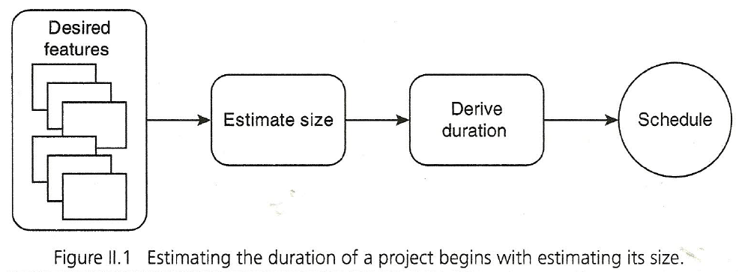

Estimating size
SOEN384-L21:: Agile scheduling

Slide 4
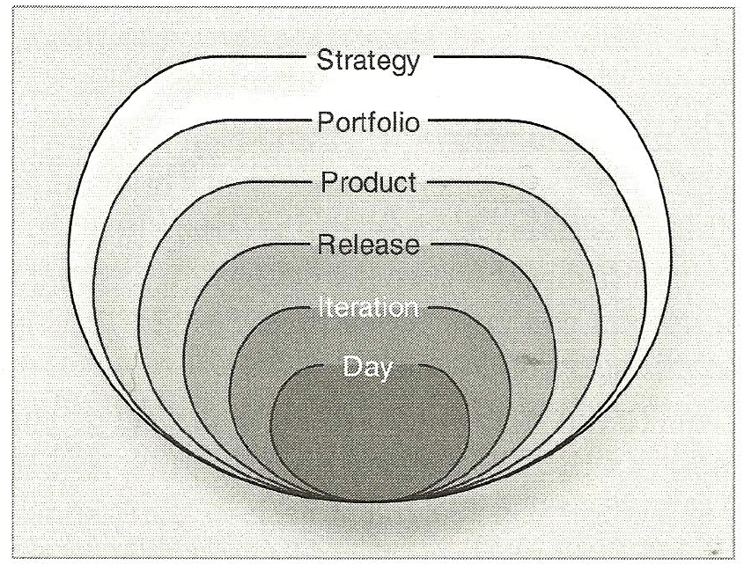

An Agile approach: the planning onion
Agile planning:
  encourages change,
  results in plans that are easily changed,
  is spread throughout the project.
Changing the plan does not mean we change the dates
SOEN384-L21:: Agile scheduling

Slide 5
Estimating in story points:
Release planning
Purpose
  To answer questions such as:
    How much will be done by April 1?
    When can we ship with this set of features?
    How many people or teams should be on this project?
Inputs
  Velocity
  The length of the project
  Prioritized product backlog
SOEN384-L21:: Agile scheduling

Slide 6
Re-estimating
When?
  A story’s relative size has changed
SOEN384-L21:: Agile scheduling

Slide 7
Splitting user stories
When?
  Doesn’t fit into a single iteration (or into the time assign to it in an iteration)
How?
  Along the boundaries of the data supported by the story
  Split large stories into separate CRUD operations
  Remove cross-cutting concerns such as concurrency, security
SOEN384-L21:: Agile scheduling

Slide 8


Planning & Estimation in Agile
“Estimates will never be anything other than approximate, however hard you try.”
- Beck & Fowler (2000)
Release Planning
Meeting:
- Features emerge
- Team estimates size
& effort for
implementation
Iteration Planning
Meeting:
- Team brainstorms
Tasks
- Everyone estimates
his/her tasks
Daily Standup
Meeting:
- Re-estimate
remaining tasks
- Record and display
effort
1 day
Prioritized for business value & criticality
2 – 4 weeks
Iteration
Backlog
Increment by
Functionality
(Fine-grain Features/Tasks)
Release
Backlog
(Coarse-grain Features)
SOEN384-L21:: Agile scheduling

Slide 9
Summary-level agenda
Review
Planning for value
Agile scheduling, tracking and communicating
SOEN384-L21:: Agile scheduling

Slide 10
Prioritizing
The value of having the features
The amount and significance of learning and new knowledge created by developing features
  product
  project
the amount of risk removed by developing the features
  schedule, cost, functionality
SOEN384-L21:: Agile scheduling

Slide 11
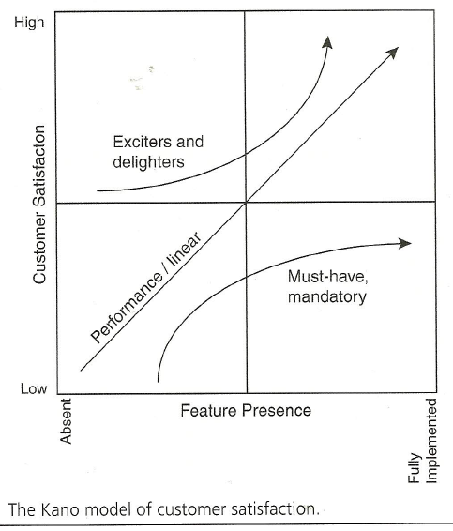
Alternative method for estimating the value: Prioritizing desirability
Kano Model of customer satisfaction
  Separate features into 3 categories:
    threshold, or must-have, features
    Linear features
    Exciters and delighters
SOEN384-L21:: Agile scheduling

Slide 12
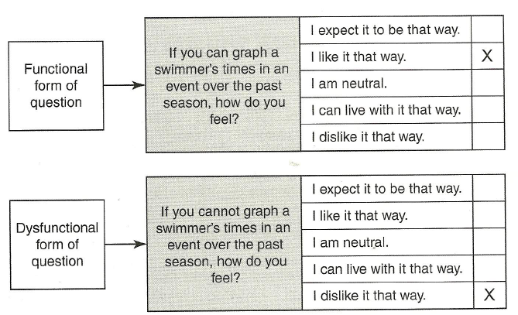
Assessing themes on the Kano model
Determine the category of each feature by asking questions:
SOEN384-L21:: Agile scheduling

Slide 13
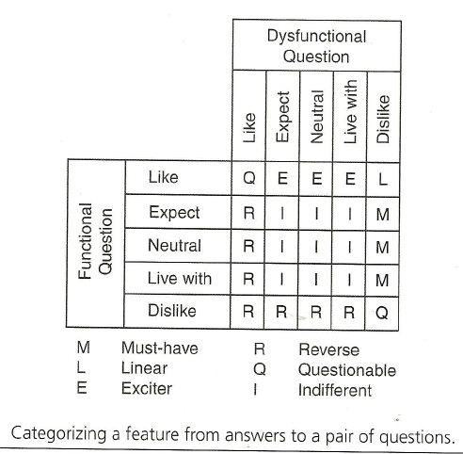
Categorizing responses:
Kano model
Cross-referencing the answers to functional and dysfunctional questions:
SOEN384-L21:: Agile scheduling

Slide 14
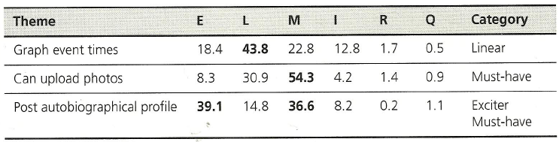
Categorizing responses:
Kano model
SOEN384-L21:: Agile scheduling

Slide 15
Prioritizing
The value of having the features
The amount and significance of learning and new knowledge created by developing features
  Product, project
the amount of risk removed by developing the features
  schedule, cost, functionality
SOEN384-L21:: Agile scheduling

Slide 16
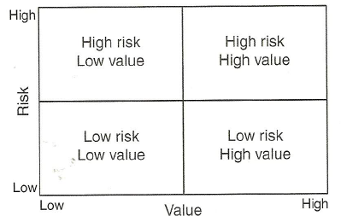
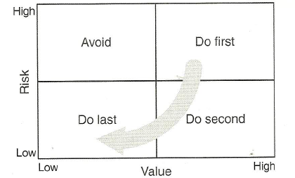
Risk – value relationship
Combining risk and value in prioritizing features
SOEN384-L21:: Agile scheduling

Slide 17
Combining the four primary factors for prioritizing
Factors:
  Value, Cost, New knowledge, Risk
Highest priority: themes with high value-to-cost ratio
The other prioritization factors will be used to adjust the priority of themes
  High risk and medium value-to-cost => high priority
SOEN384-L21:: Agile scheduling

Slide 18
Exercise
A theme on the project to which you have been assigned is of fairly low priority. Right now it looks like it will make it into the current release, but it could be dropped if time runs out. The theme needs to be developed in a language no one on the team has any familiarity with.
What do you do?
SOEN384-L21:: Agile scheduling

Slide 19
Estimating user stories
Example:
10 story points/[5 story points per iteration] = 2 iterations
SOEN384-L21:: Agile scheduling

Slide 20
Scheduling
Release planning essentials
Iteration planning
Selecting an iteration length
Estimating velocity
Buffering plans for uncertainty
SOEN384-L21:: Agile scheduling

Slide 21
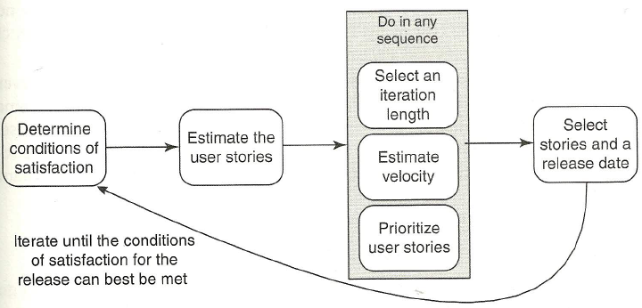
Release planning essentials
13x20 = 260 story points
[total size]
Example:
2-week
iteration;
13 iterations
Schedule (date-driven),
Scope (feature-driven),
Budget, resources
20 story points/ iteration
Place specific stories into the first 1-3 iterations, treat the rest of the release plan as one large bucket
SOEN384-L21:: Agile scheduling
Notes:
Goal: determining how much can be accomplished by what date.

Slide 22
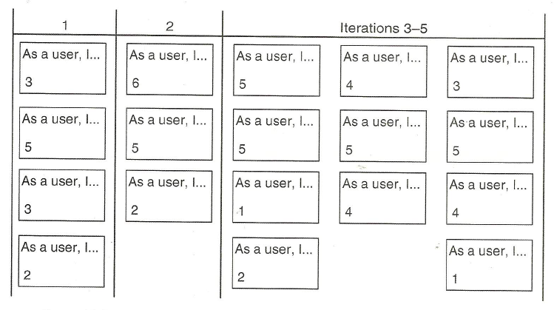
Release planning: update the release plan after each iteration!
Arranging iterations: cards are stacked to indicate which stories comprise each iteration
SOEN384-L21:: Agile scheduling

Slide 23
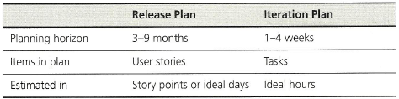
Release Plan v.s. Iteration Plan
SOEN384-L21:: Agile scheduling

Slide 24
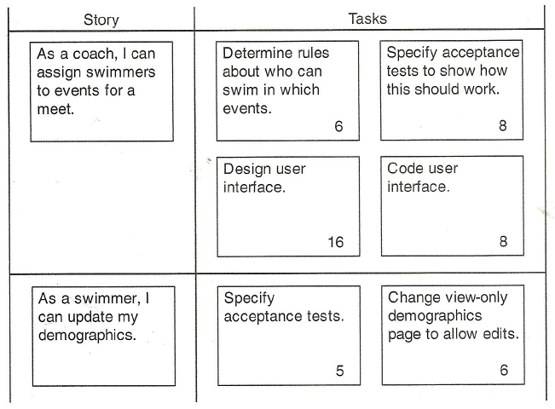
Iteration planning
Iteration planning meeting
Rule of thumb”: do not allocate tasks during the iteration planning!
SOEN384-L21:: Agile scheduling

Slide 25
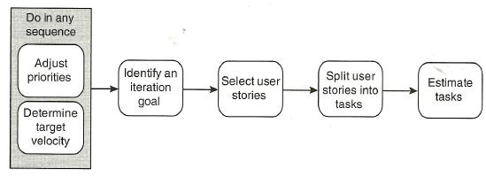
Velocity-driven iteration planning
Size of a task?
Hint: each developer should be able to finish an average of one task per day
SOEN384-L21:: Agile scheduling

Slide 26
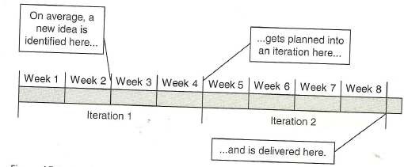
Selecting an iteration length
Each iteration is an opportunity to gather end-of-iteration feedback from stakeholders, measure progress, adjust schedule according to the gained new knowledge
Rule of thumb: at least 4-5 iterations
SOEN384-L21:: Agile scheduling

Slide 27
Buffering Plans for Uncertainty
Feature Buffers
Schedule buffers
SOEN384-L21:: Agile scheduling

Slide 28
Buffering Plans for Uncertainty: Feature Buffers
No more than 70% of the planned effort targets Must-Have requirements
30% of the effort targets Nice-to-have requirements
SOEN384-L21:: Agile scheduling

Slide 29
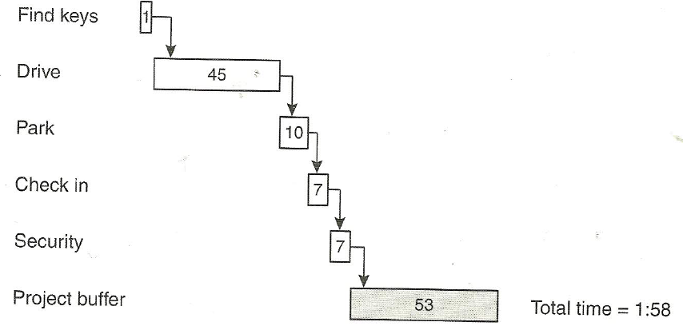

Buffering plans for uncertainty
Schedule Buffer: a margin for error around an estimate (helps avoid the Parkinson Law and Student Syndrome
a₁ =
w₁ = 6
a₂ =
w₂ = 75
a₃ =
a_{i} – the average case estimate for story i
w_{i} – the worst case estimate for story i
w₃ = 15
a₄ =
w₄ = 37
a₅ =
w₅ = 37
SOEN384-L21:: Agile scheduling

Slide 30
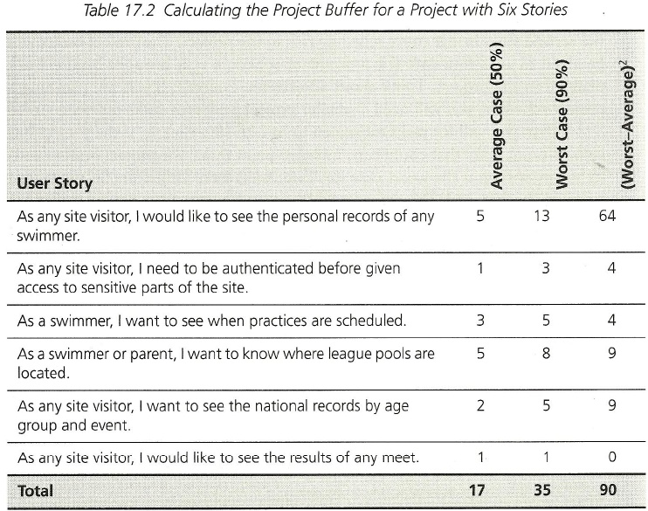
Buffering plans for uncertainty: Schedule buffer Example
w_{i} – the worst case estimate for story i
a_{i} – the average case estimate for story i
SOEN384-L21:: Agile scheduling

Slide 31
Tracking and communicating
Monitoring the release plan
Monitoring the iteration plan
Communicating about plans
SOEN384-L21:: Agile scheduling

Slide 32
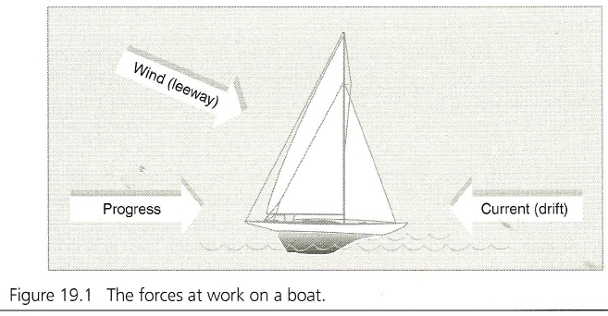
Monitoring the release plan
Tracking the release
Revised estimates
Changed requirements
Completed work
SOEN384-L21:: Agile scheduling

Slide 33
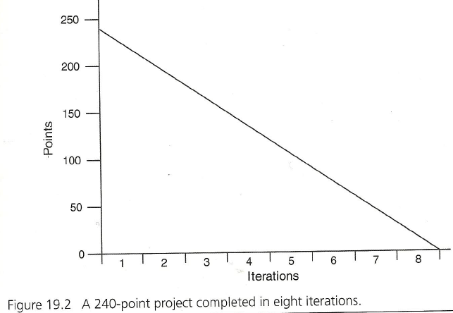
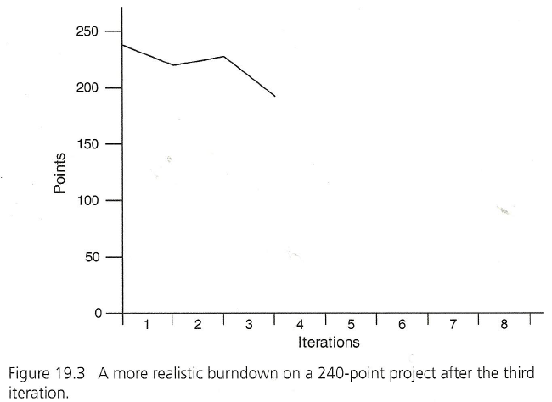
Monitoring the release plan
Release Burndown Charts
SOEN384-L21:: Agile scheduling

Slide 34
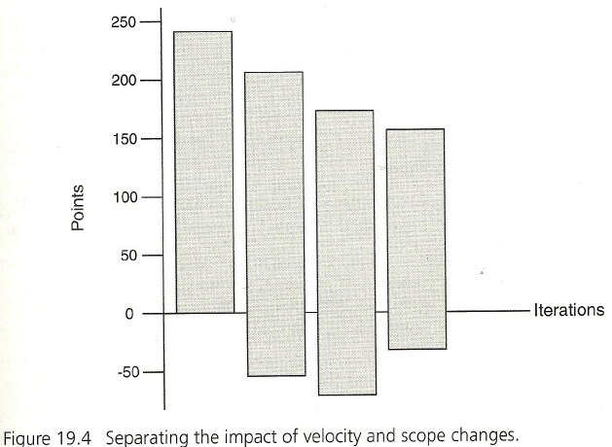
Monitoring the release plan
Release Burndown Bar Chart
Any time work is completed, the top is lowered
When work is re-estimated, the top moves up or down
When work is added, the bottom is lowered
When work is removed, the bottom is raised
SOEN384-L21:: Agile scheduling

Slide 35
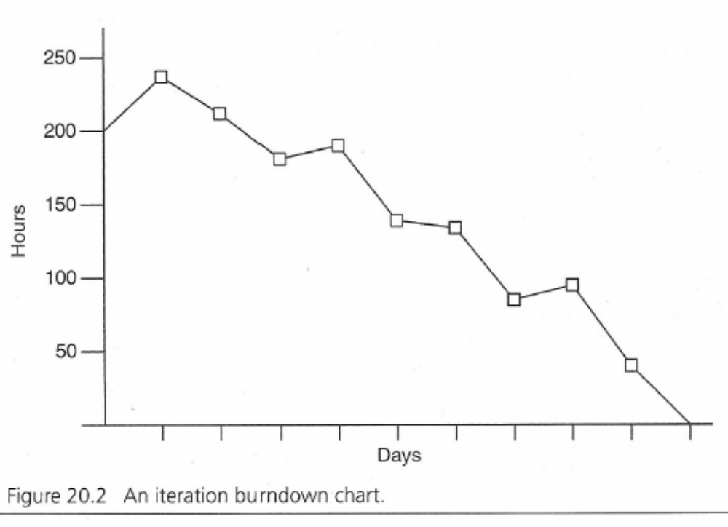
Iteration Burndown Charts
SOEN384-L21:: Agile scheduling

Slide 36
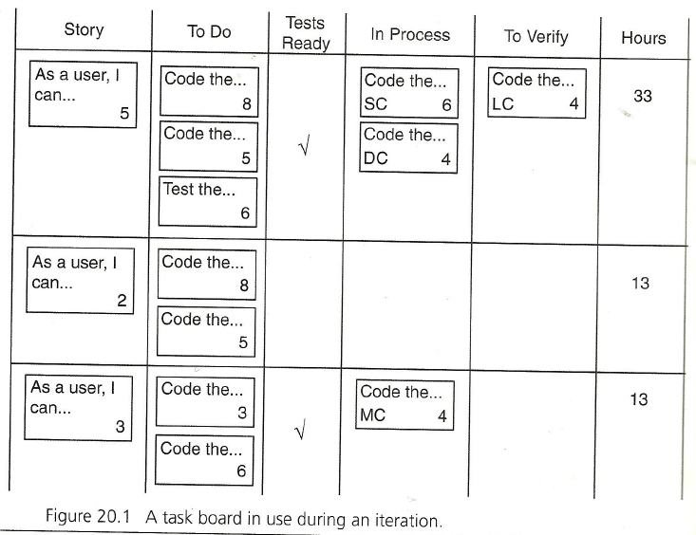
Monitoring the iteration plan
Compare effort expended with estimated effort to improve “evaluation apprehension”
SOEN384-L21:: Agile scheduling

Slide 37
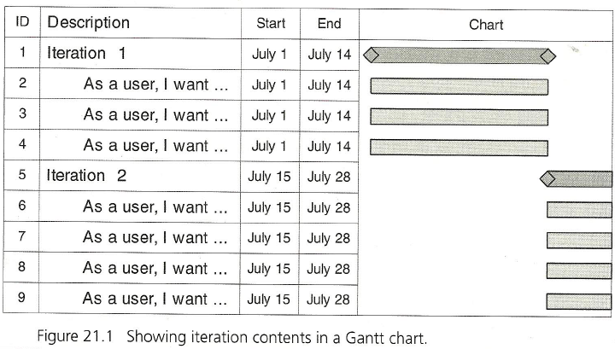

Communicating about plans
SOEN384-L21:: Agile scheduling

Slide 38
Review: Learning objectives of this Lecture
How to prioritize user stories
How to plan iterations and predict your team’s initial rate of progress
How to schedule projects that have unusually high uncertainty or schedule-related risk
Tracking and communicating
SOEN384-L21:: Agile scheduling

Slide 39
Questions?
…
SOEN384-L21:: Agile scheduling

Slide 40
Next?
Lecture Nov 20th on project retrospective. Nov 25th: quiz
Workshop on Agile estimation and planning
  10% , teams of 9-10 will be formed at the beginning of the workshop sessions
  Fridays November 27 & December 4, 8:30am-11:30am. EV12.163
November 27: Students with IDs <= 26903460 (incl.)
November 28: Students with IDs IDs > 26903460
The presence of all students is REQUIRED.
  Come on time!
  The mark for those who miss the workshop will be 0%
SOEN384-L21:: Agile scheduling

